Slide 1
Referrals & Tracking Management
Steven Bradley

Slide 2
Benefits of Advanced Referral Module
Easier, more Streamlined Follow-Up Process
Defined / Custom Referral Reasons ​
Link Relevant Patient Attachments (i.e. Lab Results)
Ability to Fax Directly from Referral Module
Bulk Actions in a Single Click
Existing Canned Report
Specific Worklist/ Dashboard for open Items
Advanced Searching & Filtering ​
Pin Capabilities
Improved Communication between Providers/Care Team ​​ ​
Enhanced Referral Status Options ​
Notes:
Lab Result Follow-up ​
Procedure Referral ​
Radiology Referral ​
Nutrition Follow-up ​
Various Program Enrollment (i.e. WIC) ​
In-House Referrals ​
Behavioral Health ​
Dental

Slide 3
Making the Referral
Creation
Assigning
Faxing

Slide 4
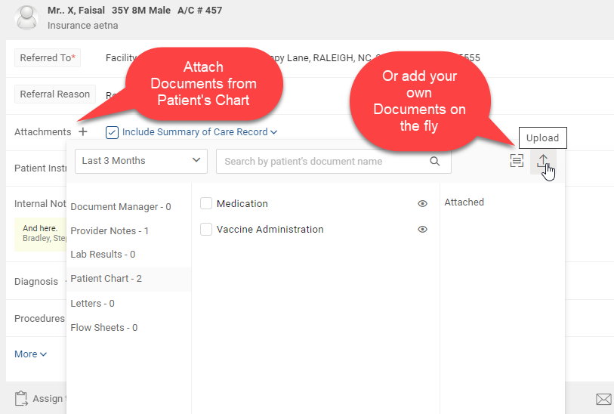
Referral Creation

Slide 5
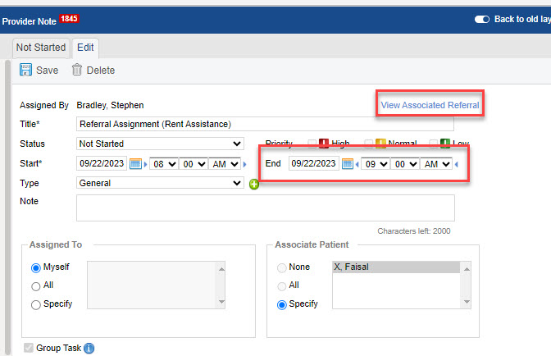
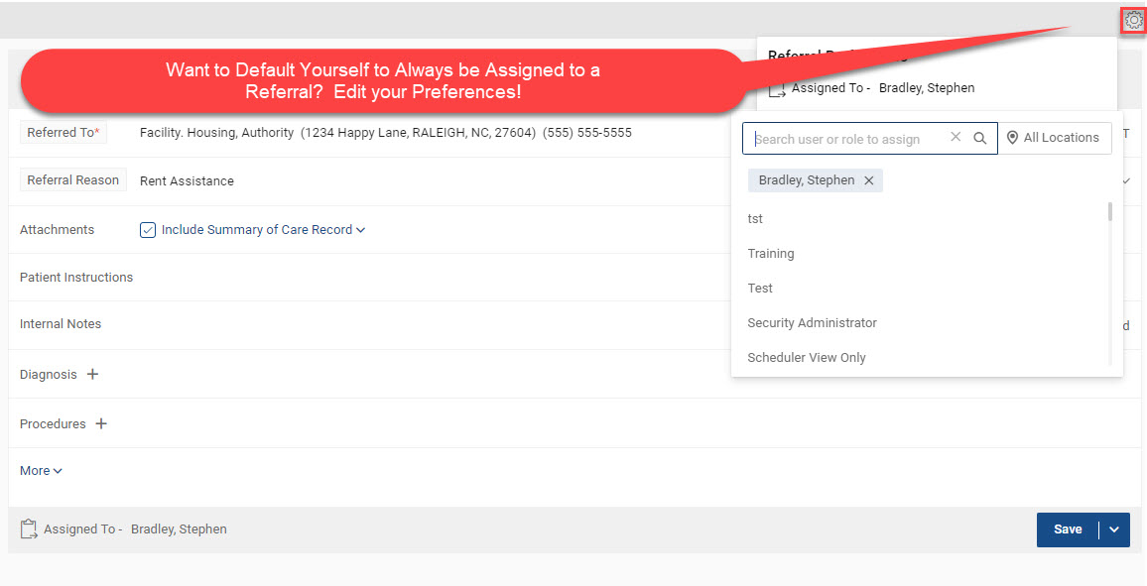
Assigning a Referral

Slide 6
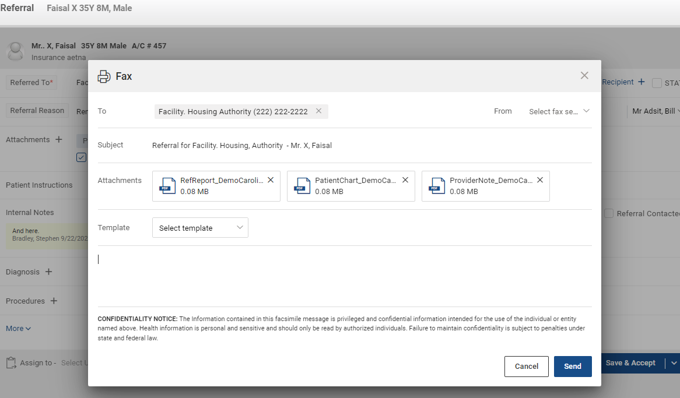
Faxing/ eMessaging Referrals

Slide 7
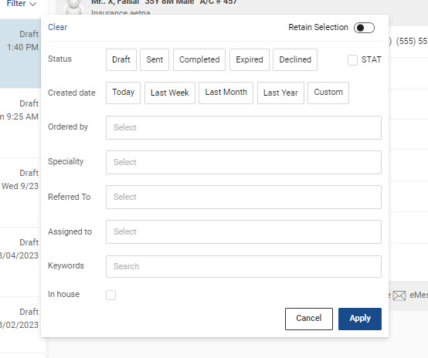
Referral Worklist

Slide 8
Follow Up Documentation

Slide 9
Closing Out

Slide 10
Incoming Referrals

Slide 11
Questions

